Slide 2

Marketing -Introduction

Slide 3
Definitions of Marketing
Chartered Institute of Marketing
American Marketing Association
Marketing is the management process responsible for identifying, anticipating and satisfying customer requirements profitably
Marketing is the process of planning and executing the conception, pricing, promotion and distribution of ideas, goods and services to create exchanges that satisfy individual and organisational objectives

Slide 4
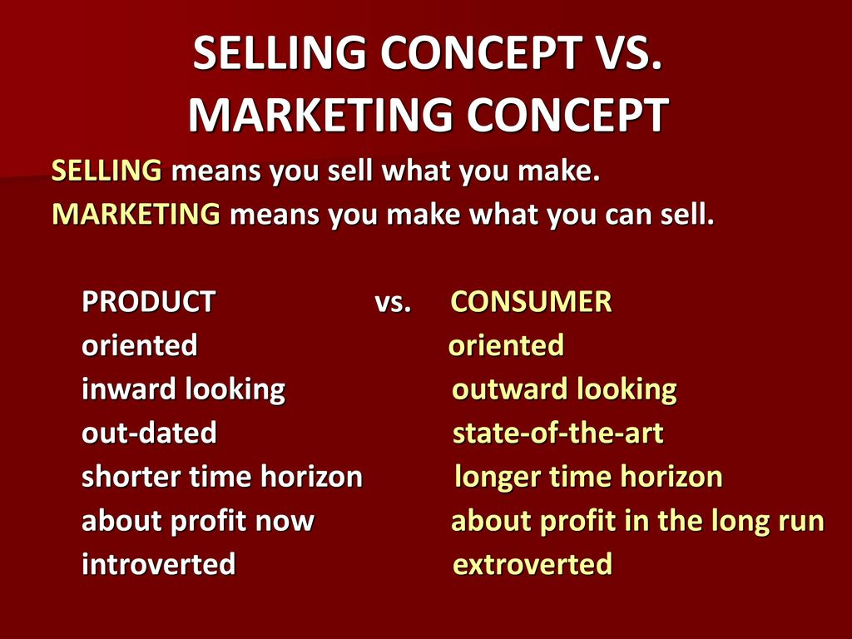

Slide 5
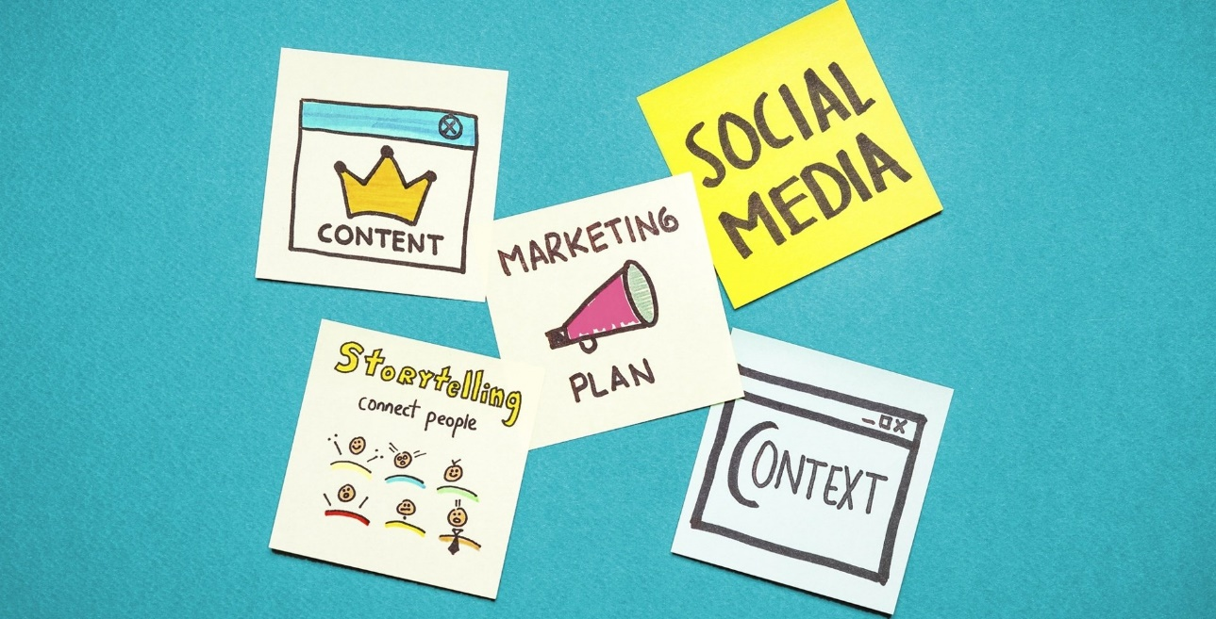
Marketing concept v marketing orientation
The marketing concept is a business philosophy that emphasises long-run profitability;
Market orientation refers to the implementation of the marketing concept that attempts to integrate marketing with other corporate functions.

Slide 6
Evolution of the marketing concept
ORIENTATION | MEANS | PROFIT RESULT
Marketing | Integrated customer focus | Long run profits through customer satisfaction
Sales | Push!! Push!! Sell!! Sell!! | Short run increases in business through sales volume
Production | Product and assembly line refinement | Profits through production controls

Slide 7
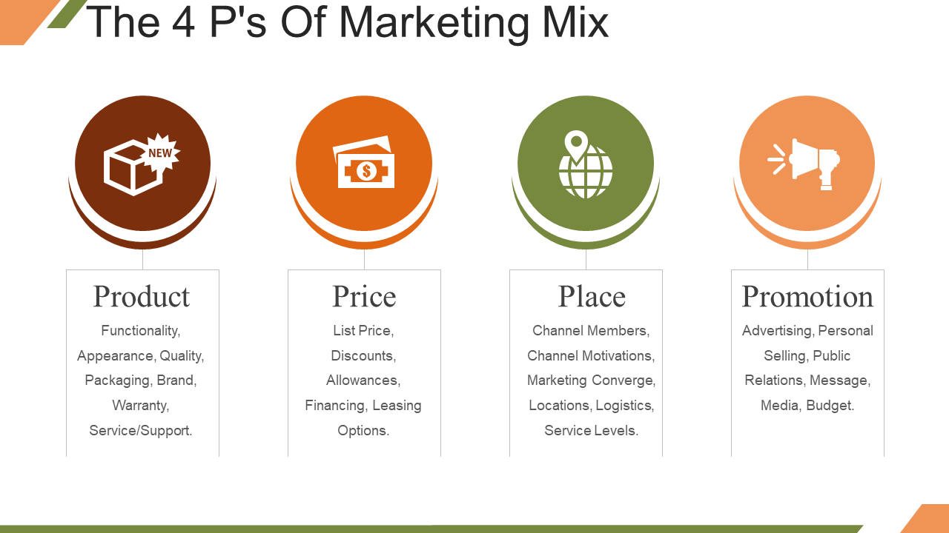
The marketing mix

Slide 8
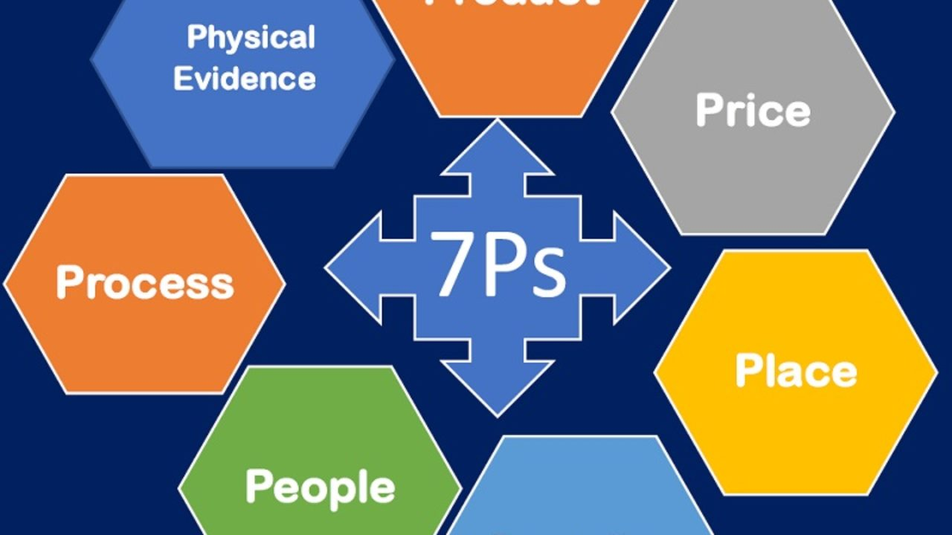

Slide 9
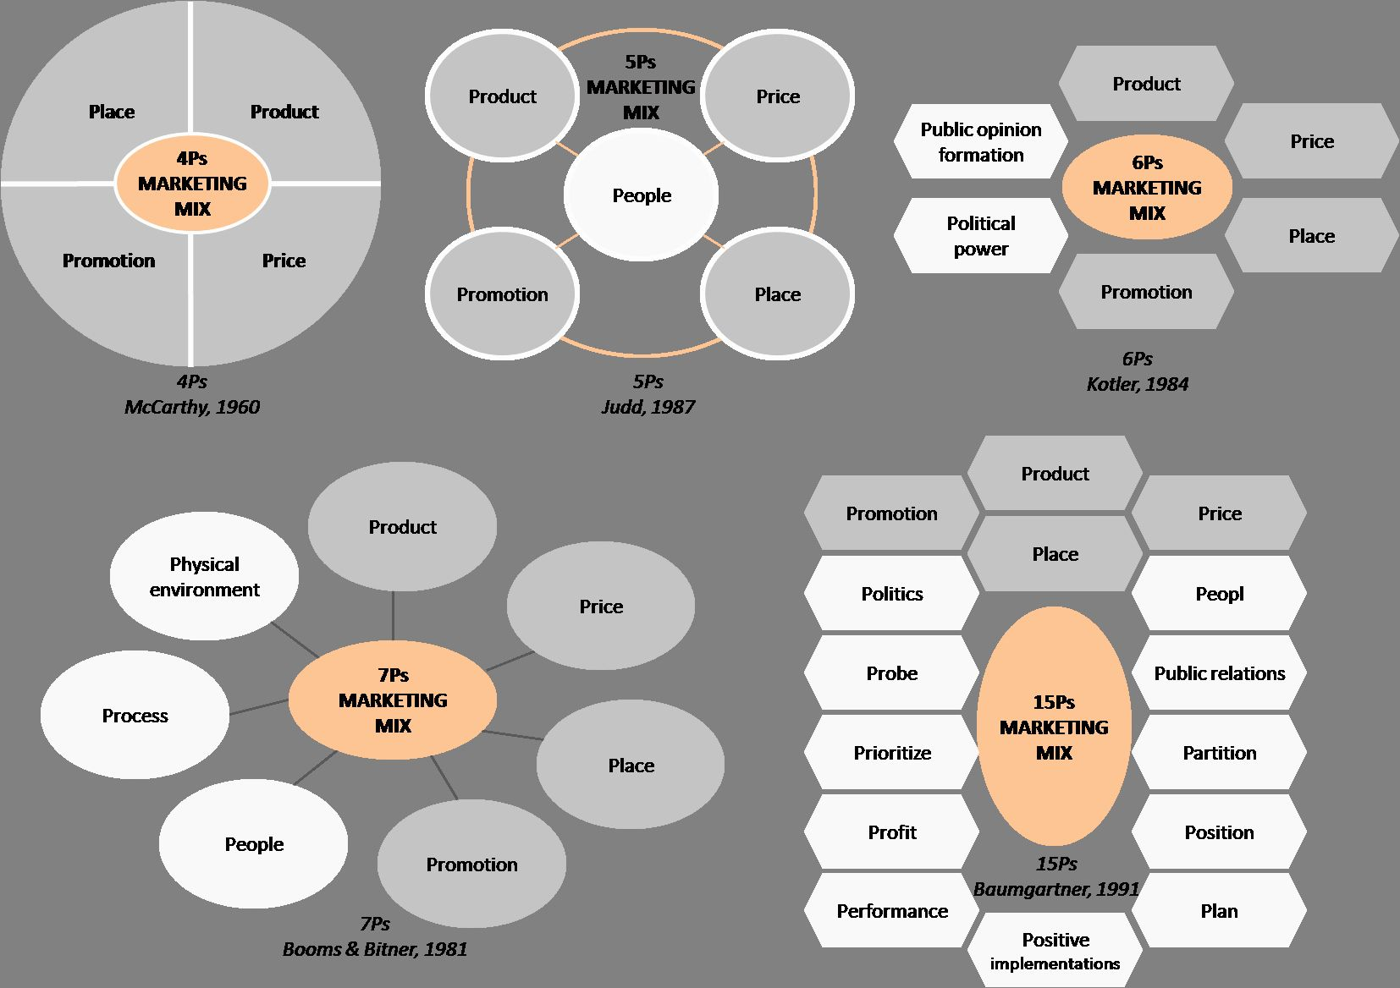

Slide 10
Marketing alongside other business functions
Board of Directors
Company Secretary
Marketing
Production
Managing Director
Services
Purchasing
R, D & D
HRM
Quality
Assurance
Finance
Strategic level (Policy)
Corporate Strategy
Operational level (Tactics)

Slide 11
Constituents of Marketing
Marketing research
Sales forecasting
Buyer behaviour
Information flow
The company
The market
Operational flow
Segmentation, targeting & positioning
Product
Communications mix (promotion)
Price
Distribution (place)
Advertising Sales Promotion Public Relations Selling Direct Marketing E-marketing
Channels
Logistics

Slide 12
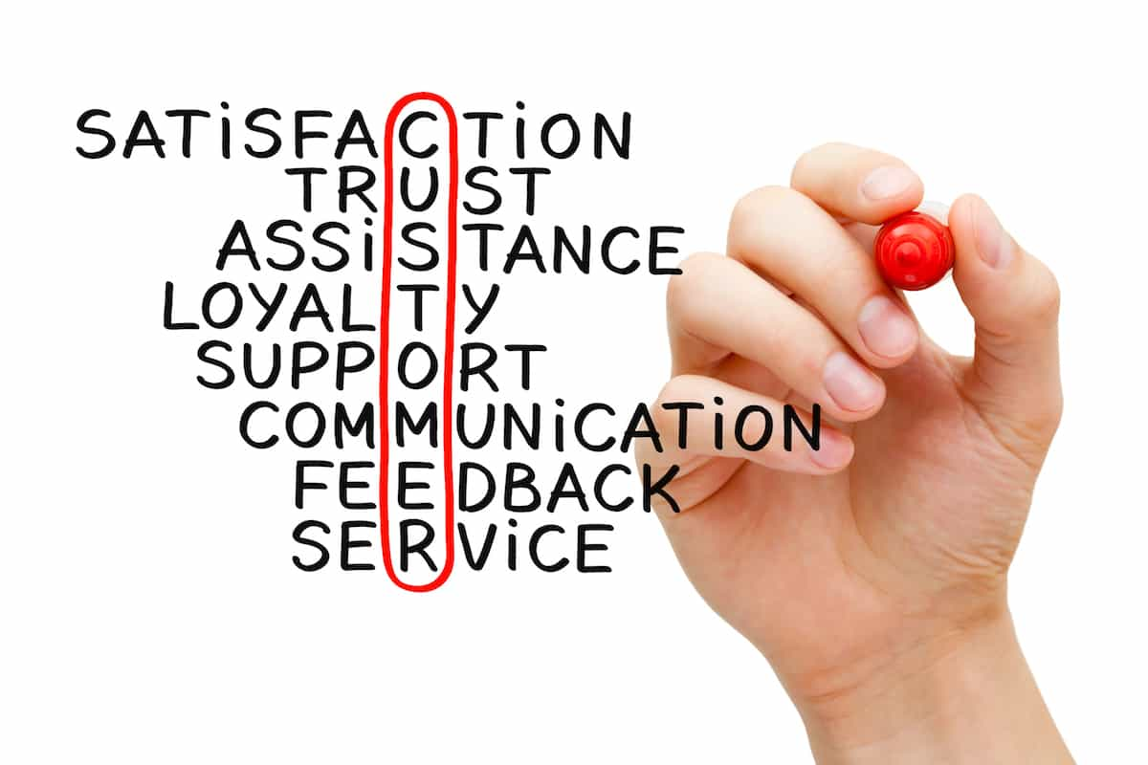
Relationship marketing (RM)

Slide 13
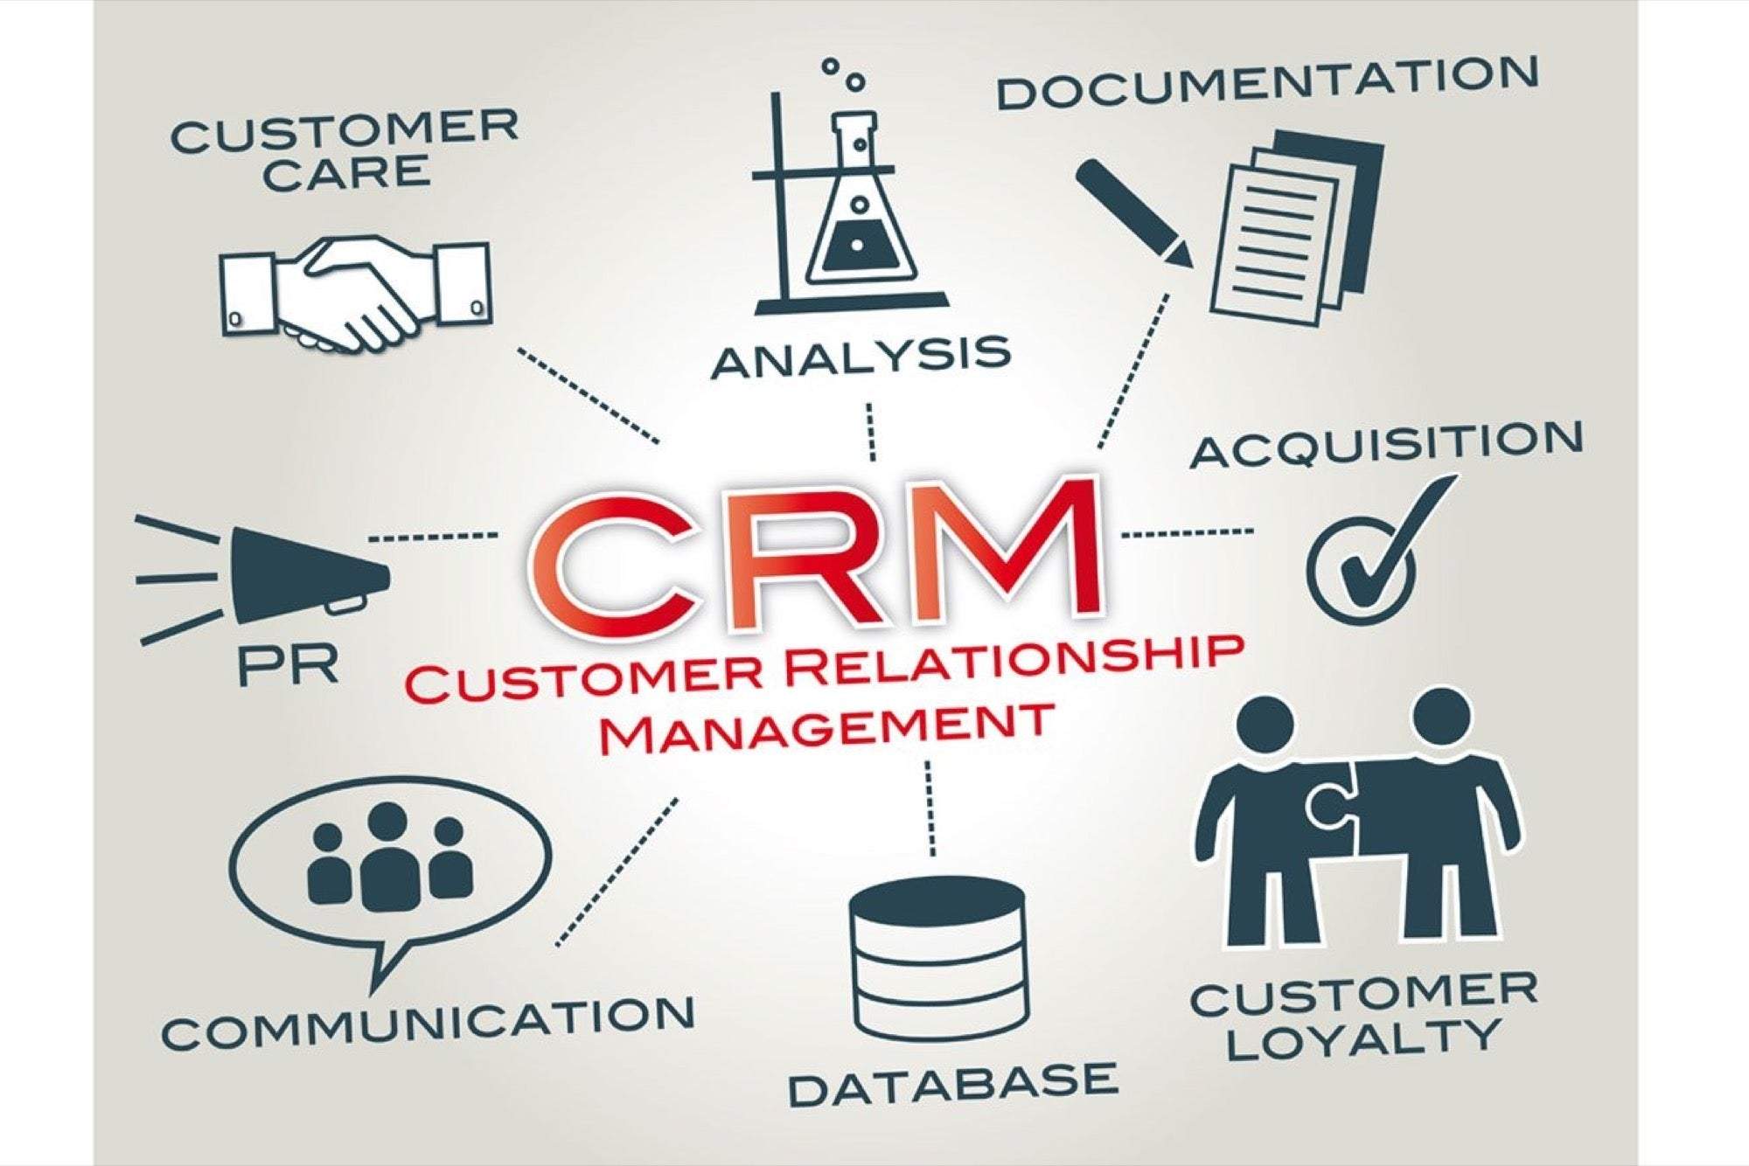
What is CRM?
An integrated and comprehensive process, providing an organisation with information about its customers, enabling it to provide the right products and services to the right customers, at the right time, at the right price, while providing the right level of quality.
Benefits:
Increased sales
Customer retention
Profitable customer relationships
Decreased operating costs
Increased margins
Increased shareholder value

Slide 14
Internal Marketing framework
Marketing strategy
Marketing implementation
Internal marketing programme
Marketing mix
External marketing programme
Marketing mix
Target groups within
the organisation
Customer groups or
target markets

Slide 15
customer care
Research by Centre of Information Based competition suggests
Up to 70% of customer decisions to buy are based on how they are treated
Only 30% is based on product attributes like price and features
Despite this, more than 80% of CRM investment focuses on matching products to customers – targeting, cross selling, up-selling, etc.
Few focus on treating customers better
A company that prides itself on its quality products and superior customer service, yet makes customers decide amongst complex options when ordering, is damaging its brand with a poorly designed customer experience
Successful application of CRM means:
Define successful sales strategies
Give customers a great experience
Develop innovative sales processes that close more business
Use best practice selling methodologies to support quality of sales process
Coach, mentor and motivate individuals to achieve peak performance

Slide 16
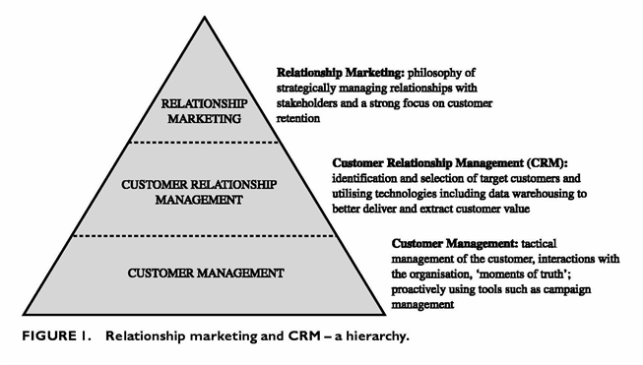
Customer Managment, CRM & RM

Slide 17
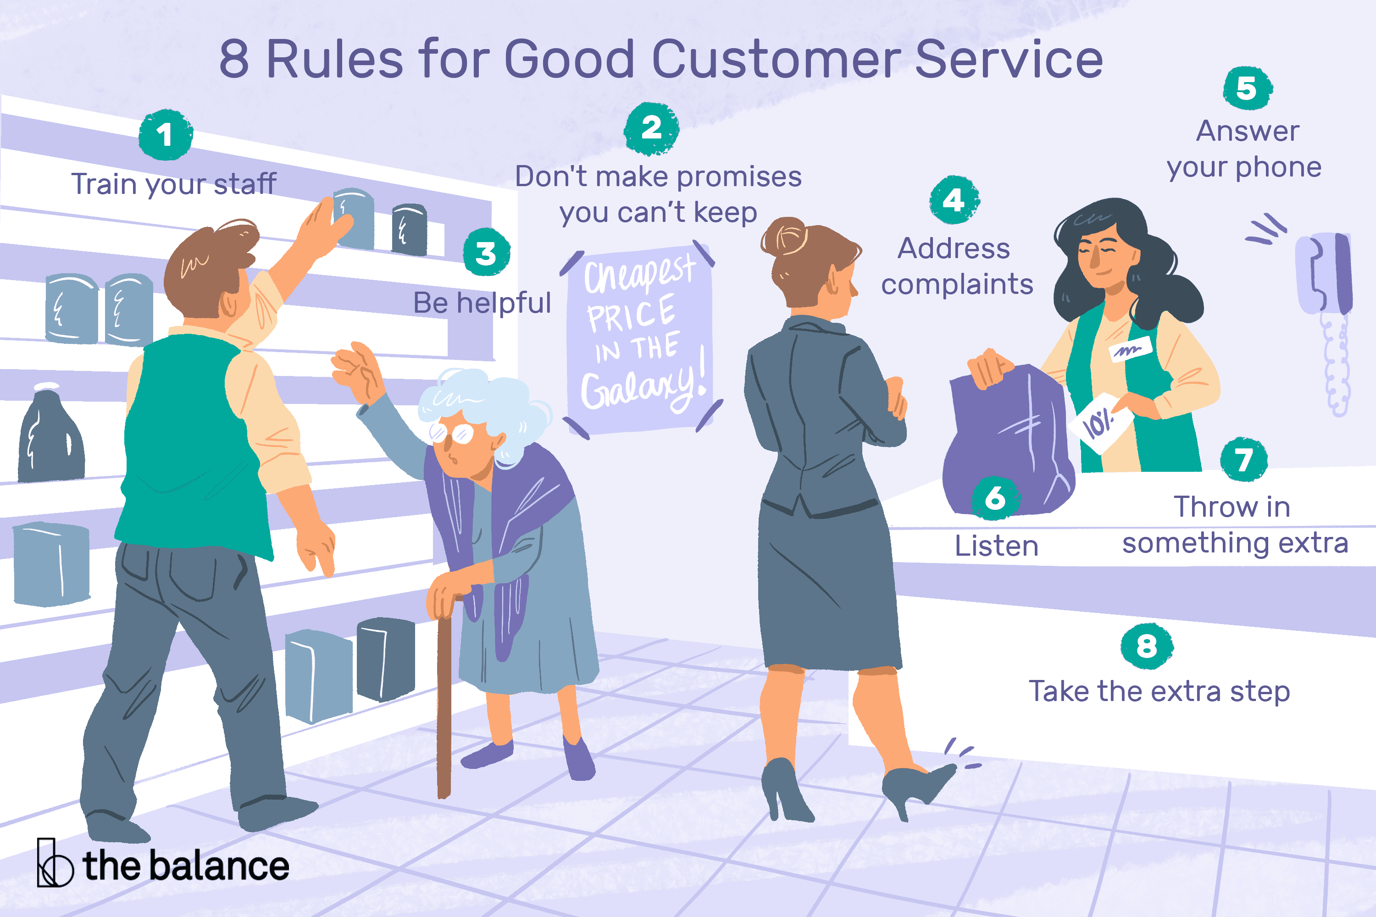
Effective customer service
Retaining customers through excellent service, produces benefits plus better revenue and profits;
It enables easier growth by sustaining healthier volumes and margins and business expansion from word-of-mouth referrals;
High levels of customer retention via effective customer service improves staff morale and motivation with better staff retention. When customers are happy, staff are happy and more productive;
Reduced customer attrition reduces litigation and legal problems;
Retaining customers enables organisation to focus on proactive opportunities (growth, innovation, development) rather than reactive crisis management and high pressures to win replacement business;
Having a culture of delighting customers fuels positive publicity and reputation in the media.

Slide 18
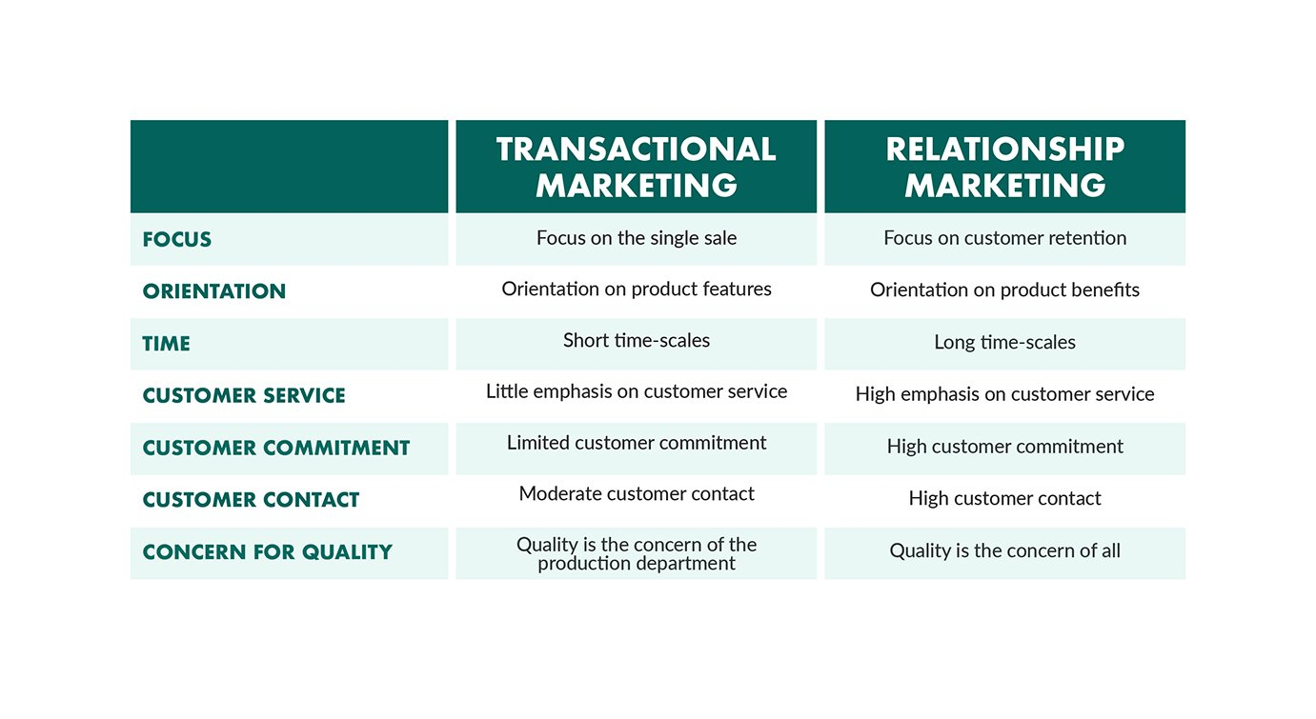

Slide 19
Relationship marketing ladder of customer loyalty
Partner
Advocate
Supporter
Client
Customer
Prospect
Customer
Keeping
Customer catching

